Slide 2

y^{y’}=const
y’lny = c
$\frac{dy}{dx}=\frac{c}{lny}$
dylny = cdx (both integral)
ylny - y =cx + c₂
y(lny-1)=cx + c₂
y/elny/e=cx + c₂

Slide 3
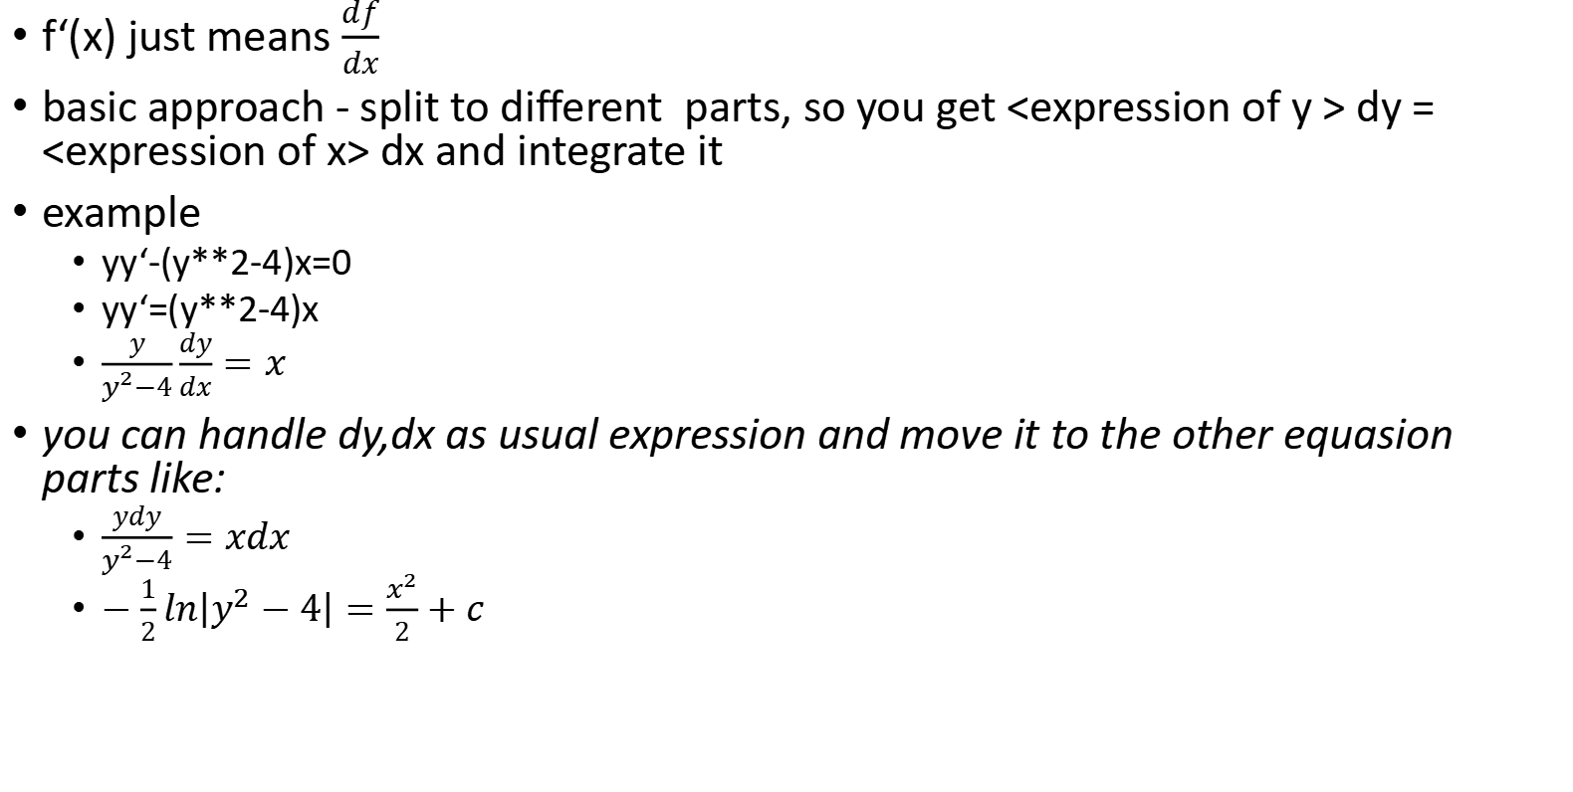
Basic approach
f‘(x) just means $\frac{df}{dx}$
basic approach - split to different parts, so you get <expression of y > dy = <expression of x> dx and integrate it
example
yy‘-(y**2-4)x=0
yy‘=(y**2-4)x
$\frac{y}{y^{2}−4}\frac{dy}{dx}=x$
you can handle dy,dx as usual expression and move it to the other equasion parts like:
$\frac{ydy}{y^{2}−4}=xdx$
$−\frac{1}{2}ln\left|y^{2}−4\right|=\frac{x^{2}}{2}+c$

Slide 4
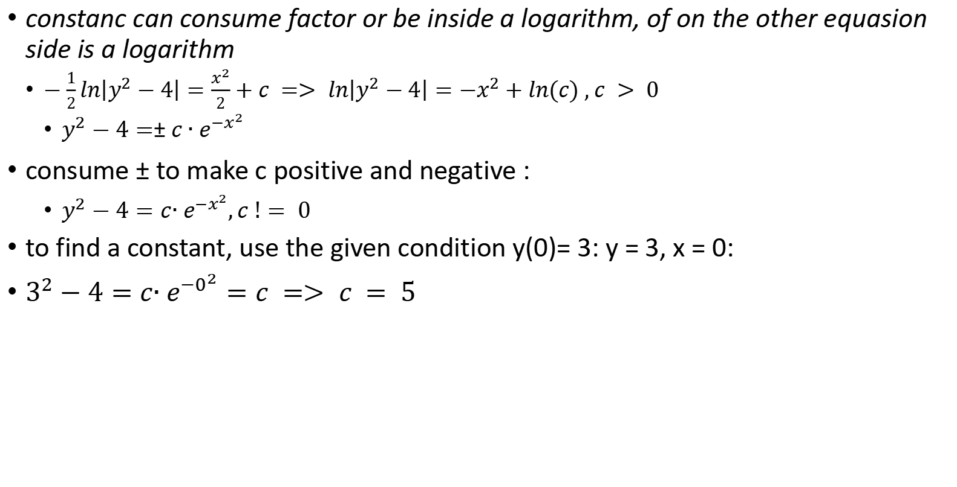
Basic approach - constants
constanc can consume factor or be inside a logarithm, of on the other equasion side is a logarithm
$−\frac{1}{2}ln\left|y^{2}−4\right|=\frac{x^{2}}{2}+c => ln\left|y^{2}−4\right|={−x}^{2}+ln(c) , c > 0$
$y^{2}−4=±{c∙e}^{−x^{2}}$
consume $±$ to make c positive and negative :
$y^{2}−4=c{∙e}^{−x^{2}},c != 0$
to find a constant, use the given condition y(0)= 3: y = 3, x = 0:
$3^{2}−4=c{∙e}^{−0^{2}}=c => c = 5$

Slide 5

Basic Example
$x^{2}y‘+y^{2}=0; y(−1)=1$
$x^{2}\frac{dy}{dx}=−y^{2}$
move y and dy, x and dx in different parts of equasion:
$\frac{dy}{−y^{2} }=\frac{dx}{x^{2}}$
integrate and solve:
$\int{\frac{dy}{−y^{2} }}=\int{\frac{dx}{x^{2}}}$
$\frac{1}{y}=−\frac{1}{x}+c$
subsisute y(-1)=1
1 =1+c => c = 0
answer : y = -x

Slide 6
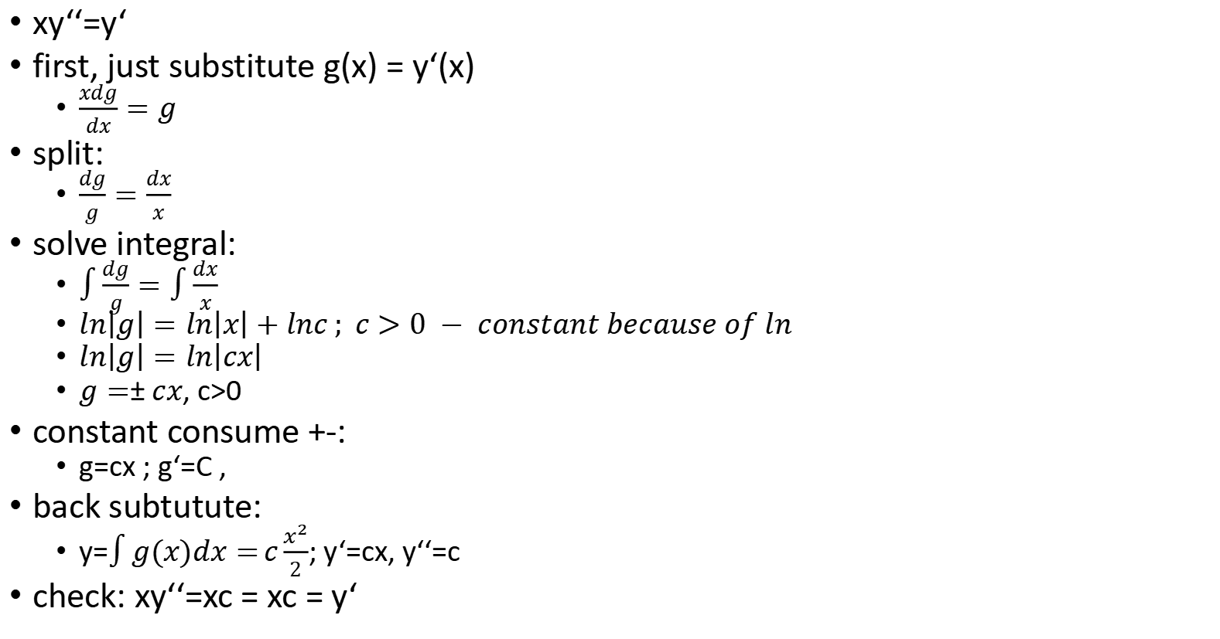
Basic example 2
xy‘‘=y‘
first, just substitute g(x) = y‘(x)
$\frac{xdg}{dx}=g$
split:
$\frac{dg}{g}=\frac{dx}{x}$
solve integral:
$\int{\frac{dg}{g}}=\int{\frac{dx}{x} }$
$ln\left|g\right|=ln\left|x\right|+lnc ; c>0 − constant because of ln$
$ln\left|g\right|=ln\left|cx\right|$
$g=±cx$, c>0
constant consume +-:
g=cx ; g‘=C ‚
back subtutute:
y=$\int{g(x)dx=}c\frac{x^{2}}{2}$; y‘=cx, y‘‘=c
check: xy‘‘=xc = xc = y‘

Slide 7
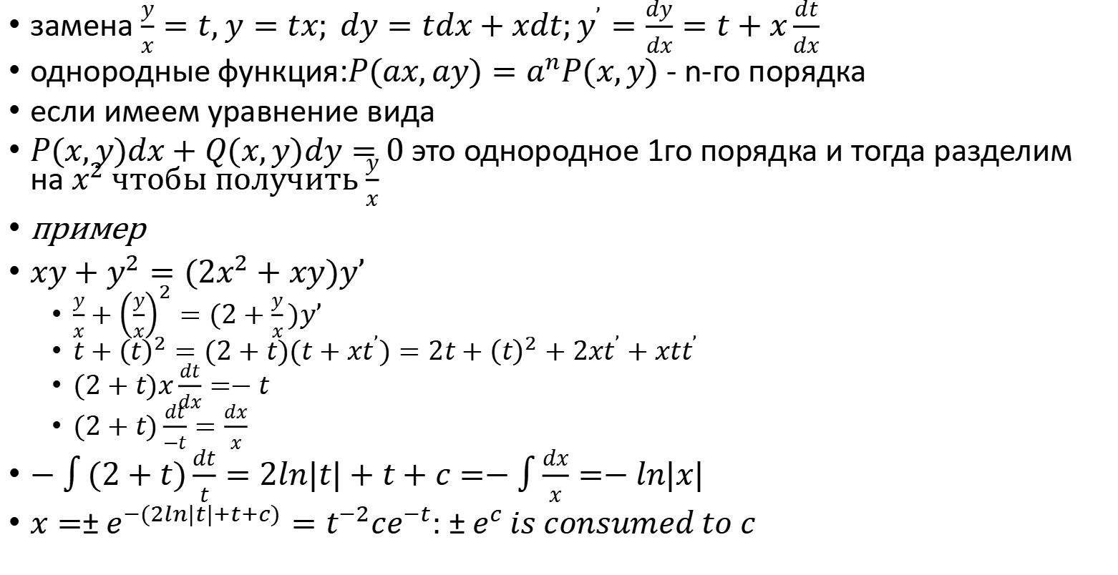
Однородные первого порядка $y^{’}=g(\frac{y}{x})$
замена $\frac{y}{x}=t, y=tx; dy=tdx+xdt;y^{’}=\frac{dy}{dx}=t+x\frac{dt}{dx}$
однородные функция:$P(ax,ay)=a^{n}P(x,y)$ - n-го порядка
если имеем уравнение вида
$P(x,y)dx+Q(x,y)dy=0$это однородное 1го порядка и тогда разделим на $x^{2}$чтобы получить $\frac{y}{x}$
пример
$xy+y^{2}=(2x^{2}+xy)y’$
$\frac{y}{x}+{\left(\frac{y}{x}\right)}^{2}=(2+\frac{y}{x})y’$
$t+{\left(t\right)}^{2}=(2+t)(t+xt^{’})=2t+{\left(t\right)}^{2}+2xt^{’}+xtt^{’}$
$(2+t)x\frac{dt}{dx}=−t$
$(2+t)\frac{dt}{−t}=\frac{dx}{x}$
$−\int{(2+t)\frac{dt}{t}=2ln|t|+t}+c=−\int{\frac{dx}{x}}=−ln|x|$
$x=±e^{−(2ln|t|+t+c)}=t^{−2}ce^{−t}:±e^{c} is consumed to c$

Slide 8
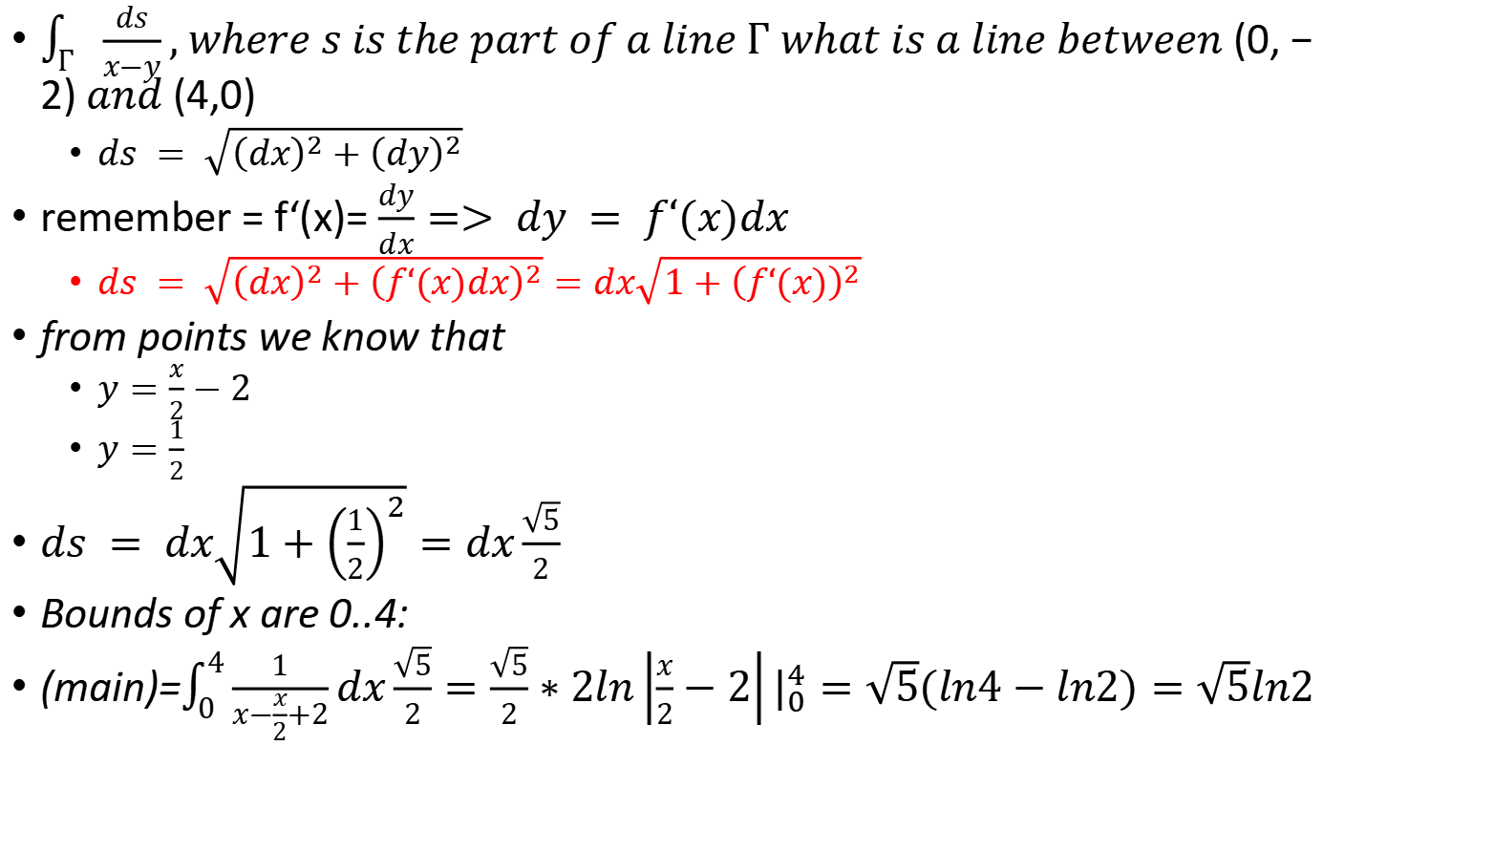
Integral along the line
$\int_{Г}{\frac{ds}{x−y}}, where s is the part of a line Г what is a line between (0,−2) and (4,0)$
$ds = \sqrt{{\left(dx\right)}^{2}+{\left(dy\right)}^{2}}$
remember = f‘(x)= $\frac{dy}{dx}=> dy = f‘(x)dx$
$ds = \sqrt{{\left(dx\right)}^{2}+{\left(f‘(x)dx\right)}^{2}}=dx\sqrt{1+{\left(f‘(x)\right)}^{2}}$
from points we know that
$y=\frac{x}{2}−2$
$y=\frac{1}{2}$
$ds = dx\sqrt{1+{\left(\frac{1}{2}\right)}^{2}}=dx\frac{\sqrt{5}}{2}$
Bounds of x are 0..4:
(main)=$\int_{0}^{4}{\frac{1}{x−\frac{x}{2}+2}}dx\frac{\sqrt{5}}{2}=\frac{\sqrt{5}}{2}∗2ln\left|\frac{x}{2}−2\right||_{0}^{4}=\sqrt{5}(ln4−ln2)=\sqrt{5}ln2$

Slide 9
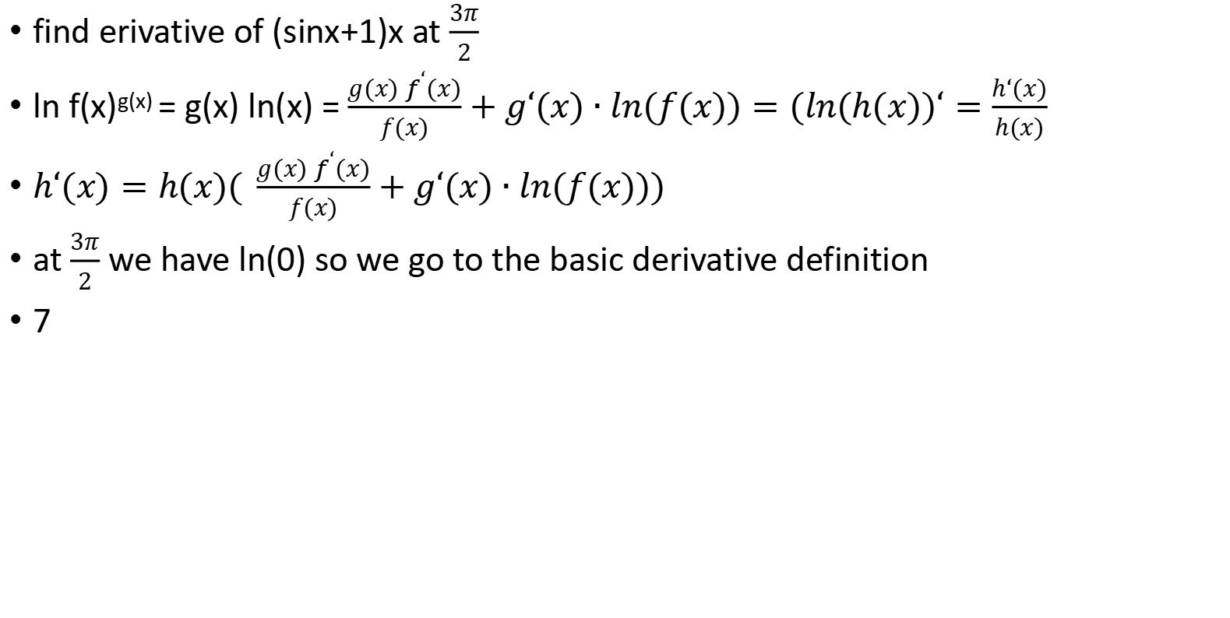
find erivative of (sinx+1)x at $\frac{3π}{2}$
ln f(x)^{g(x)} = g(x) ln(x) = $\frac{g(x) f^{‘}(x)}{f(x)}+g‘(x)∙ln(f(x))=(ln(h(x))‘=\frac{h‘(x)}{h(x)}$
$h‘(x)=h(x)( \frac{g(x) f^{‘}(x)}{f(x)}+g‘(x)∙ln(f(x)))$
at $\frac{3π}{2}$ we have ln(0) so we go to the basic derivative definition
7

Slide 10
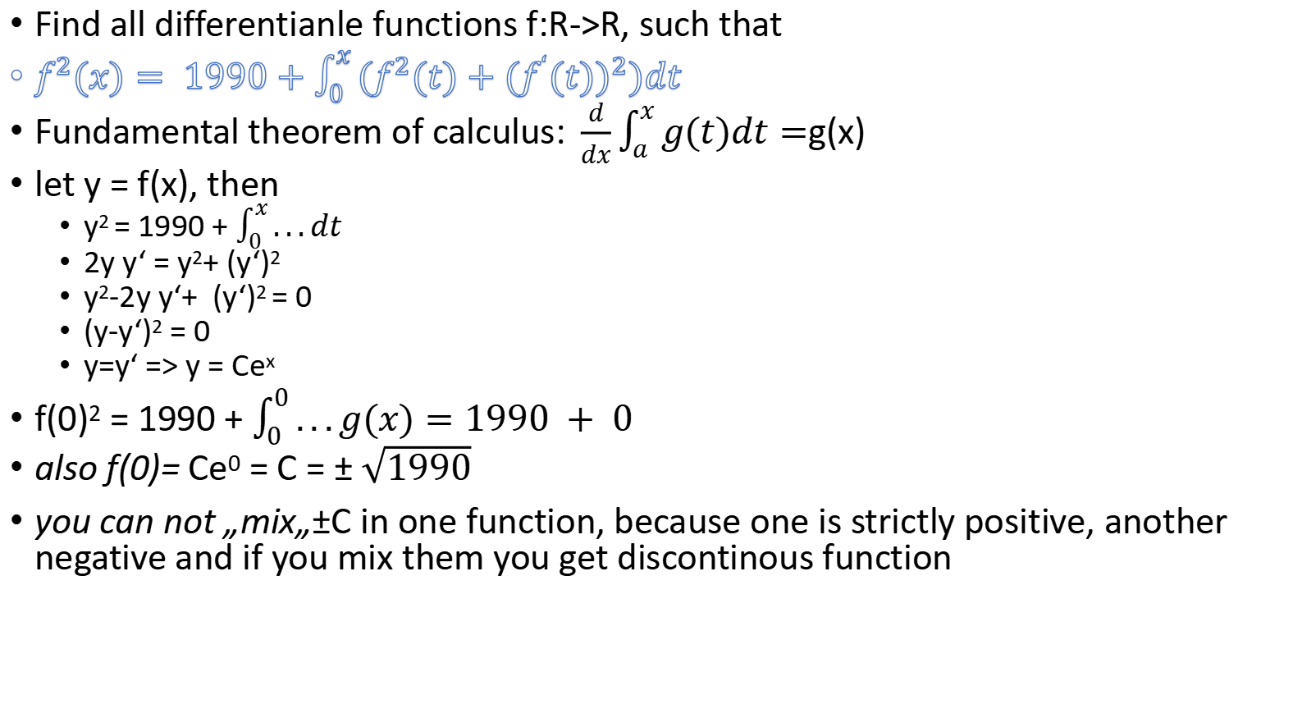
Find all differentianle functions f:R->R, such that
$f^{2}(x)= 1990+\int_{0}^{x}{(f^{2}(t)+{{(f}^{‘}(t))}^{2})dt}$
Fundamental theorem of calculus:$\frac{d}{dx}\int_{a}^{x}{g(t)dt=}$g(x)
let y = f(x), then
y² = 1990 + $\int_{0}^{x}{...dt}$
2y y‘ = y²+ (y‘)²
y²-2y y‘+ (y‘)² = 0
(y-y‘)² = 0
y=y‘ => y = Ce^{x}
f(0)² = 1990 + $\int_{0}^{0}{...g(x)=1990 + 0}$
also f(0)= Ce⁰ = C = $±\sqrt{1990}$
you can not „mix„$±$C in one function, because one is strictly positive, another negative and if you mix them you get discontinous function

Slide 11

$$yy’cos(x)=(1−y)sin(x)$$
$\frac{yy’}{1−y}=tan(x);y’=\frac{dy}{dx}$
$\int{\frac{ydy}{1−y}}=\int{tan(x)dx} or y = 1$
$\int{\frac{1}{1−y}}dy−\int{dy}=\int{tan(x)dx}$
$−ln|1−y|−y=−ln|cosx|+c$
$ln|1−y|+y=ln|cosx|+c$
$|1−y|e^{y}=cos(x)∗C_{2};C_{2}>0$

Slide 12
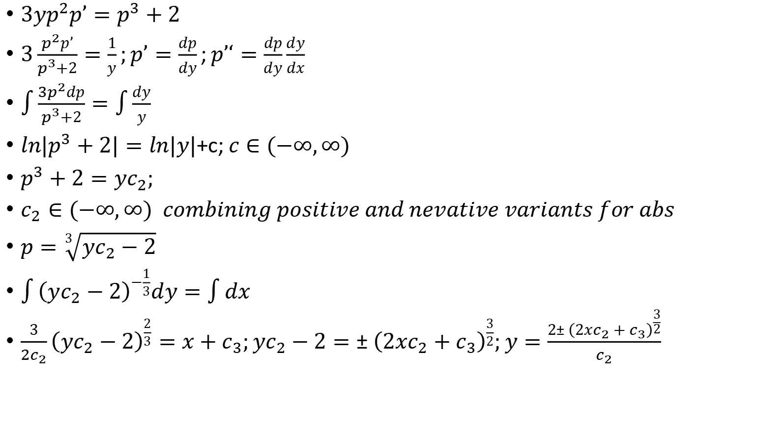
$$3yy’y”={y’}^{3}+2$$
$3yp^{2}p’=p^{3}+2$
$3\frac{p^{2}p’}{p^{3}+2}=\frac{1}{y};p’=\frac{dp}{dy};p’‘=\frac{dp}{dy}\frac{dy}{dx}$
$\int{\frac{{3p}^{2}dp}{p^{3}+2}=\int{\frac{dy}{y}}}$
$ln|p^{3}+2|=ln|y|$+c;$c∈(−∞,∞)$
$p^{3}+2=yc_{2};$
$c_{2}∈(−∞,∞) combining positive and nevative variants for abs$
$p=\sqrt[3]{yc_{2}−2}$
$\int{{\left(yc_{2}−2\right)}^{−\frac{1}{3}}dy}=\int{dx}$
$\frac{3}{{2c}_{2}}{\left(yc_{2}−2\right)}^{\frac{2}{3}}=x+c_{3};yc_{2}−2={±\left(2xc_{2}+c_{3}\right)}^{\frac{3}{2}};y=\frac{2{±\left(2xc_{2}+c_{3}\right)}^{\frac{3}{2}}}{c_{2}}$

